Slide 1
Mental Illness In Tech World
ML RESEARCH INTERNS TEAM 7.1

Slide 2
ABSTRACT
In this time of rush and competition, people go through many types of pressures and stress which ultimately causes mental disorders like Hypertension, anxiety, depression, insomnia and physical changes like high blood pressure, low energy and loss of sexual desires and/or ability.
Especially in the world of technology, this is very common among people to have physical and mental illness due to stress of work.
Employees of these companies operate under the same high-stress: late nights, abnormal hours, and tight deadlines, all while wearing multiple hats and being constantly available at any time of day.

Slide 3

Especially in the world of technology, this is very common among people to have physical and mental illness due to stress of work.
Despite all the conversations and how far we've come, mental health is still heavily stigmatized. It’s viewed as a shameful personal deficiency, a failure or weakness, and most people don’t feel comfortable admitting they are dealing with it for fear of being judged by their peers.
So our project will analyse the effect of multiple factors on the health of a person and will predict the need & probability of treatment for him.

Slide 4
TECHNOLOGY STACK
Jupyter Notebook.
Python APIs like Tensorflow, sklearn, keras, matplotlib, pandas etc.
Google colab for GPU based modelling.
Flask/streamlit/django for end product deployment.
Github for version control.

Slide 5

IDEA EXPLANATION
First of all, the dataset would be collected from Kaggle.
Our project will predict whether a patient should be treated of his/her mental illness or not according to the values obtained in the dataset?
The timeline of the project will be continued from the next slide.

Slide 6
TIMELINE
LIBRARY AND DATA LOADING: Required libraries will be imported and the dataset will be imported in the csv format.
DATA CLEANING: The data will be cleaned according to our usage and project requirement so that it eases our work.
DATA ENCODING: Checking Nan values and variability comparison between categories of variables.
DATA VISUALIZATION: Some charts to see data relationship.

Slide 7
SCALING AND FITTING DATA: It is also known as data normalization and is generally performed during the data preprocessing step.
TUNING DATA: Tuning is the process of maximizing a model's performance without overfitting or creating too high of a variance. In machine learning, this is accomplished by selecting appropriate “hyperparameters”. We will first evaluate a classification model which will further evaluate Classification accuracy, Null accuracy, percentage of ones and zeros and confusion matrix. Then will be using Cross Validation Score, GridSearch CV, and RandomizedSearch CV for our best hyperparameters.
EVALUATING MODELS: It is an integral part of the model development process. It helps to find the best model that represents our data and how well the chosen model will work in the future. Model evaluation metrics are used to assess goodness of fit between model and data, to compare different models, in the context of model selection, and to predict how predictions are expected to be accurate.

Slide 8
MAKING PREDICTIONS: After training our model, and evaluating it, We can now use the trained model to predict whether a patient needs treatment or not.
PREPARE SUBMISSION FILE: We make submissions in CSV files. Your submissions usually have two columns: an ID column and a prediction column. The ID field comes from the test data (keeping whatever name the ID field had in that data, which for our data is the index). The prediction column will use the name of the target field. We will create a DataFrame with this data, and then use the ‘to_csv’ method to write our submission file. Explicitly include the argument index=False to prevent pandas from adding another column in our csv file.

Slide 9
PROCEDURE
1. Data cleaning
2. Encoding Data
3. Checking for missing data
4. Covariance Matrix. Variability comparison between categories of variables
5. Data Visualisation
6. Scaling & fitting
7. Splitting dataset
8. Importing models
9. Evaluating models

Slide 10
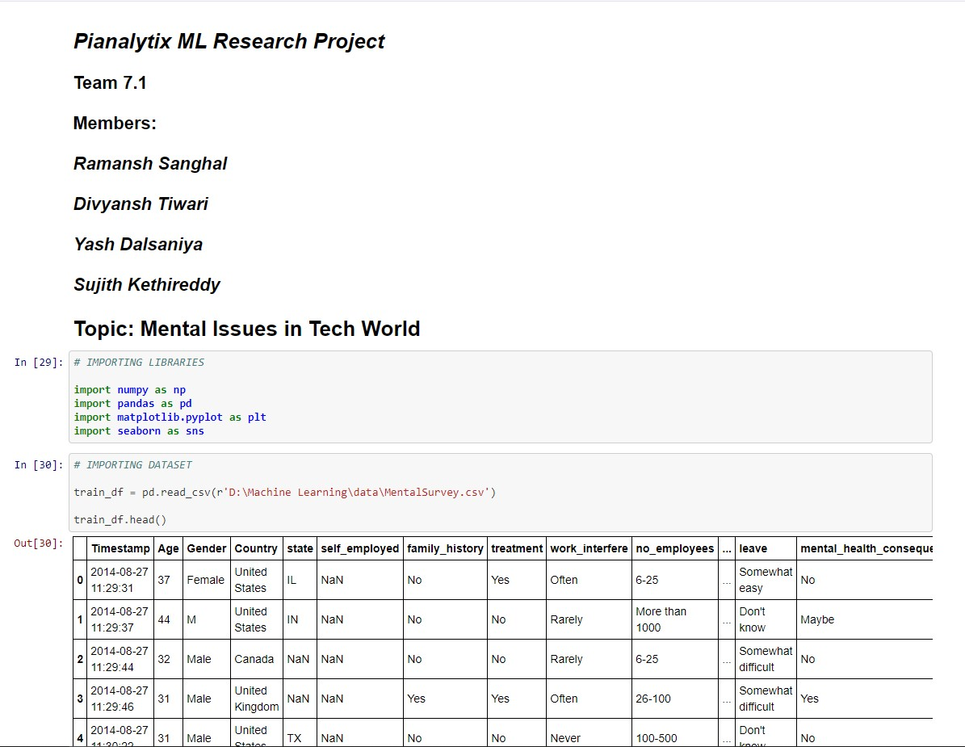
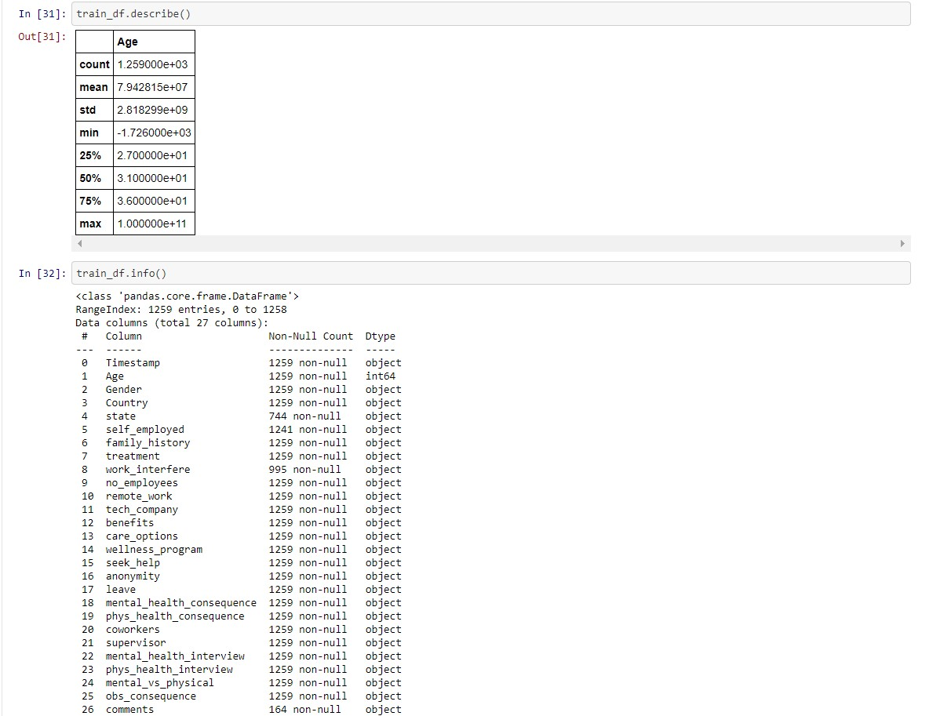

Slide 11
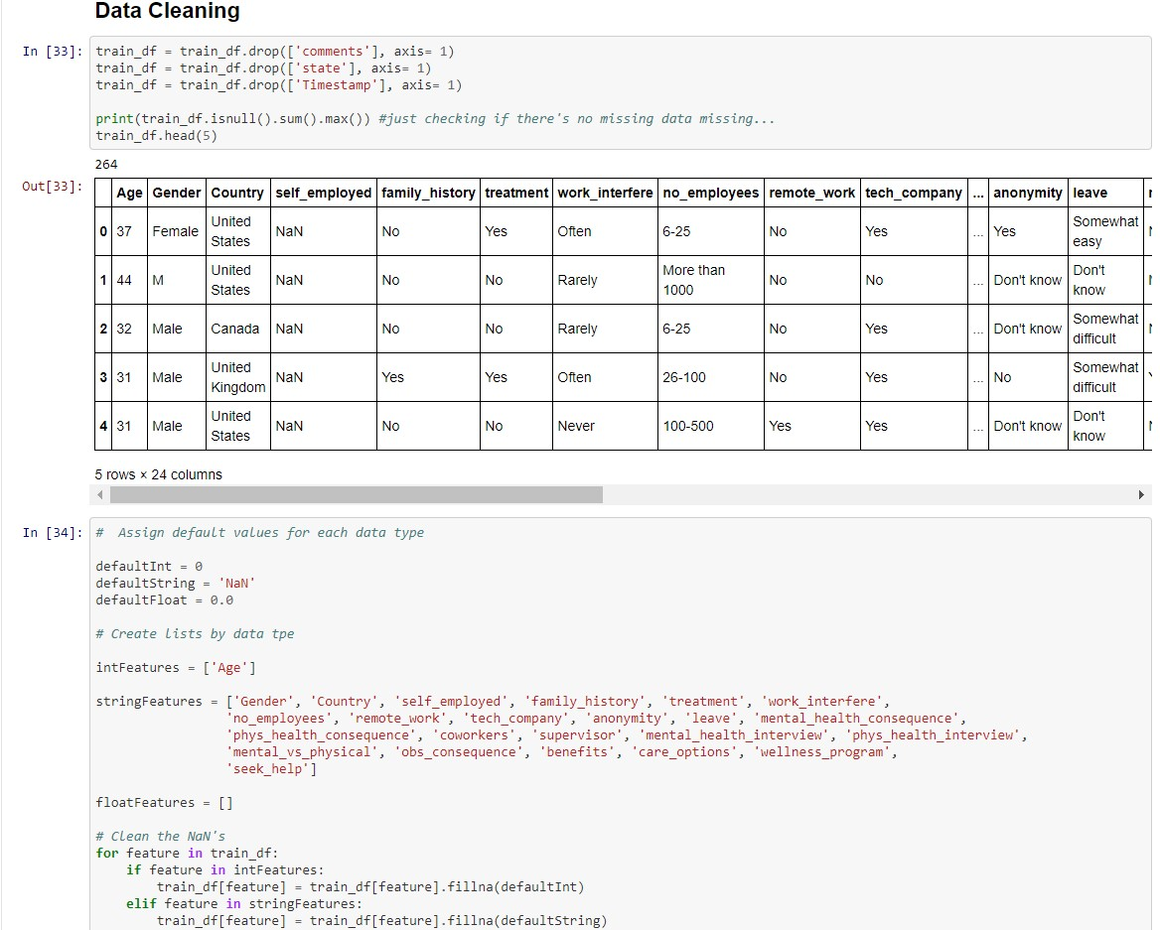
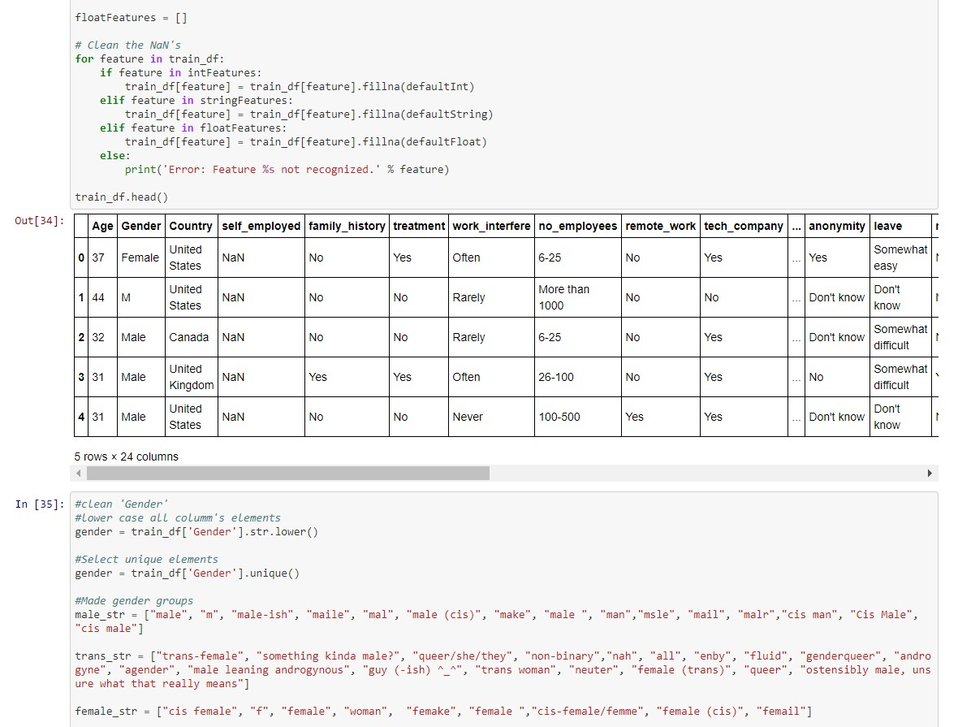

Slide 12
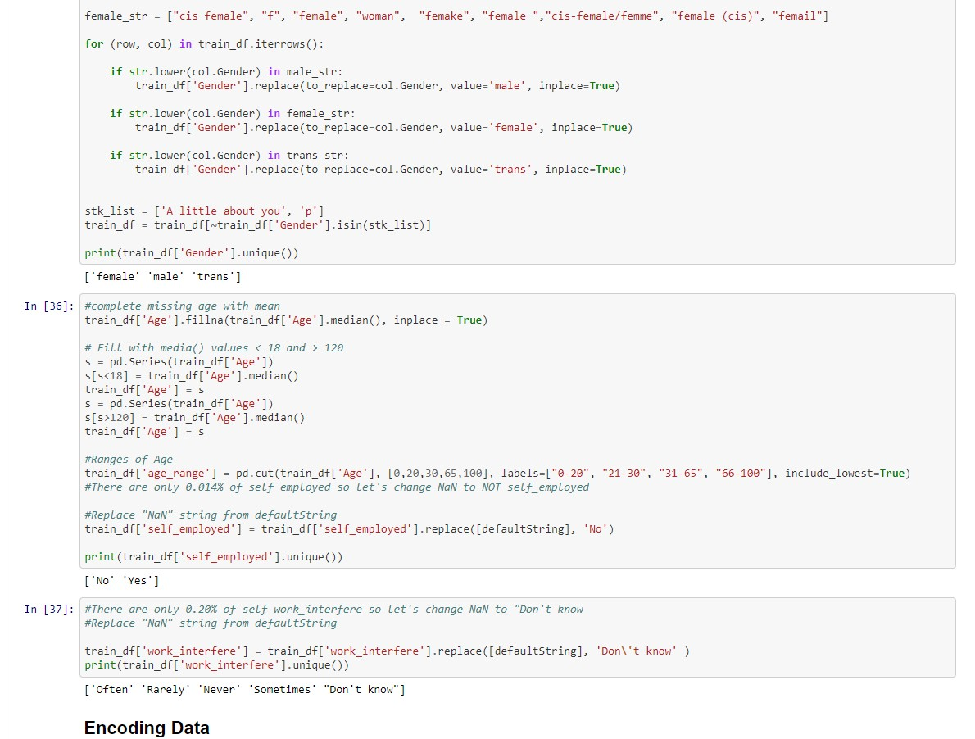
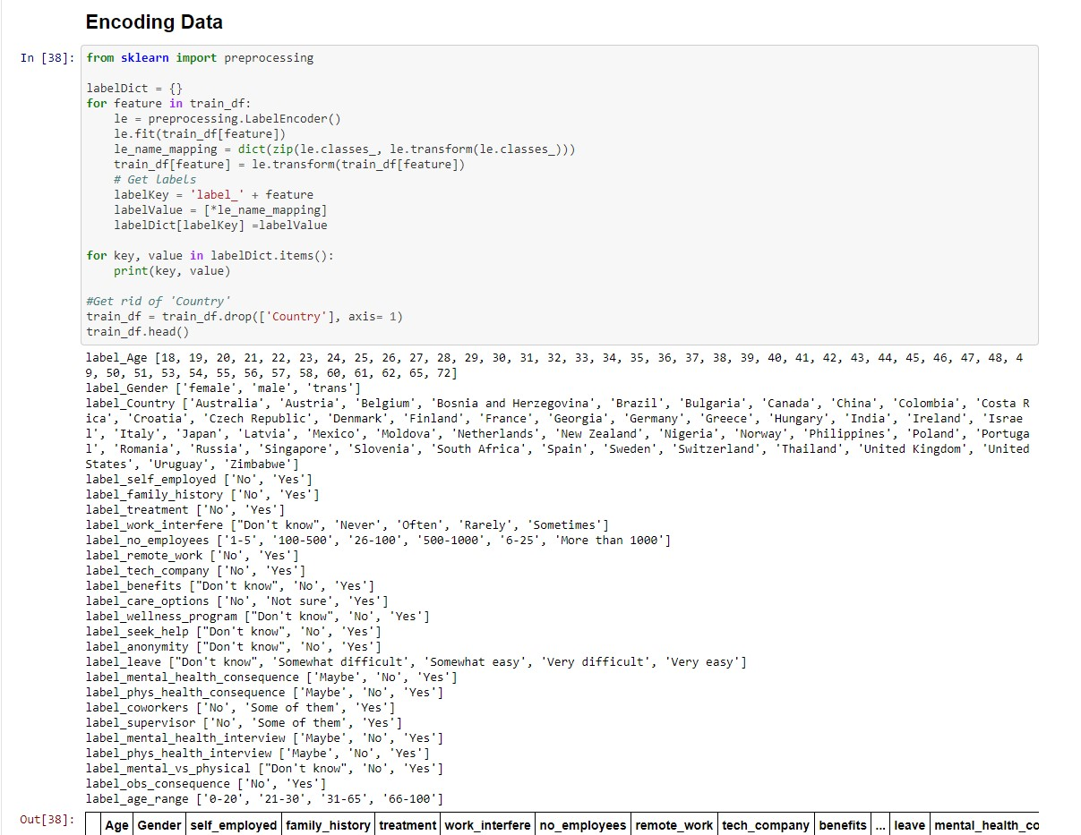

Slide 13
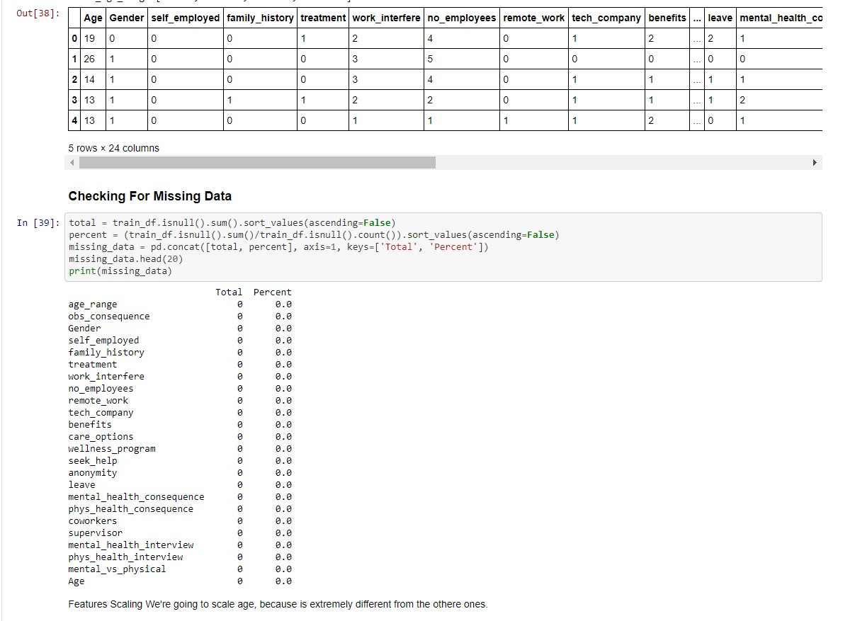
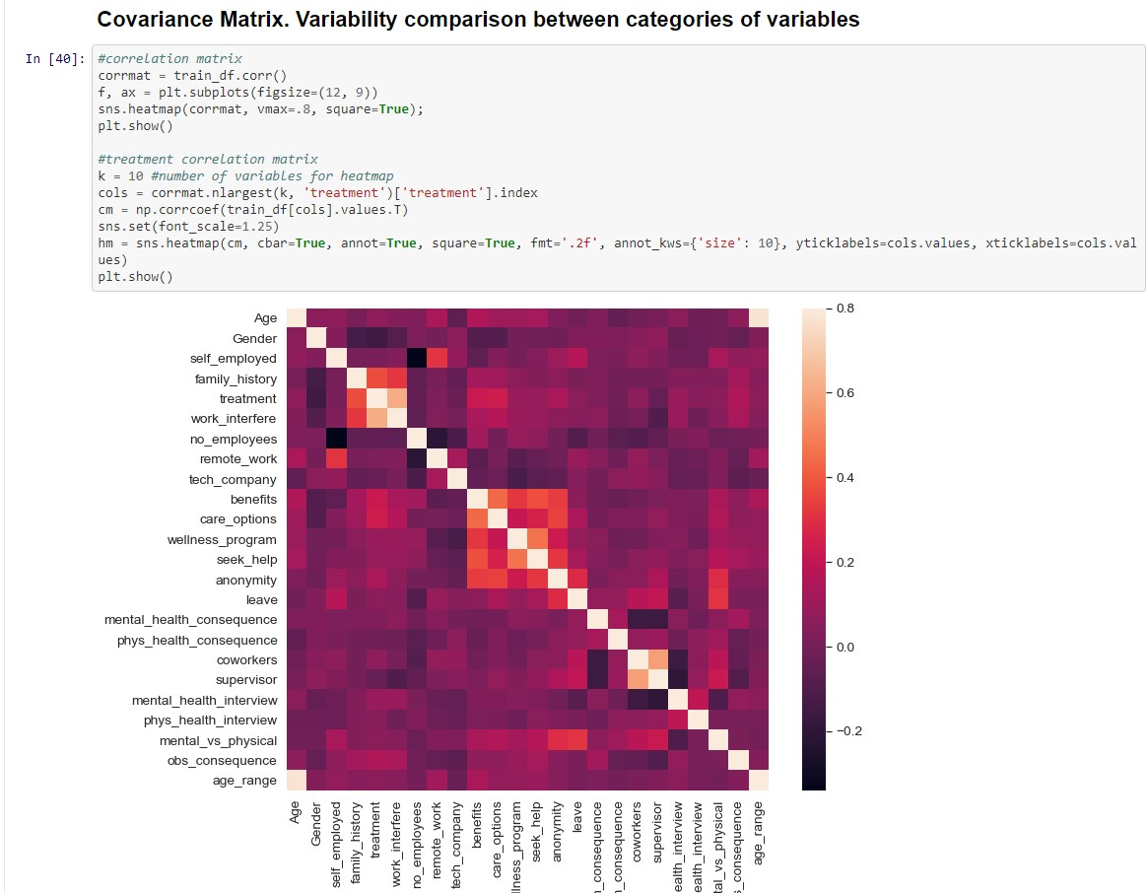

Slide 14
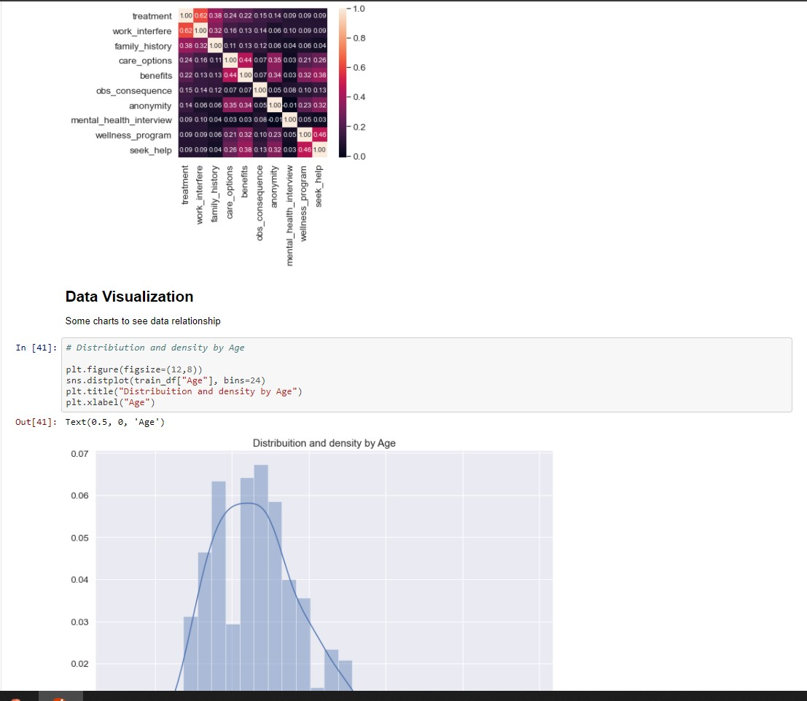
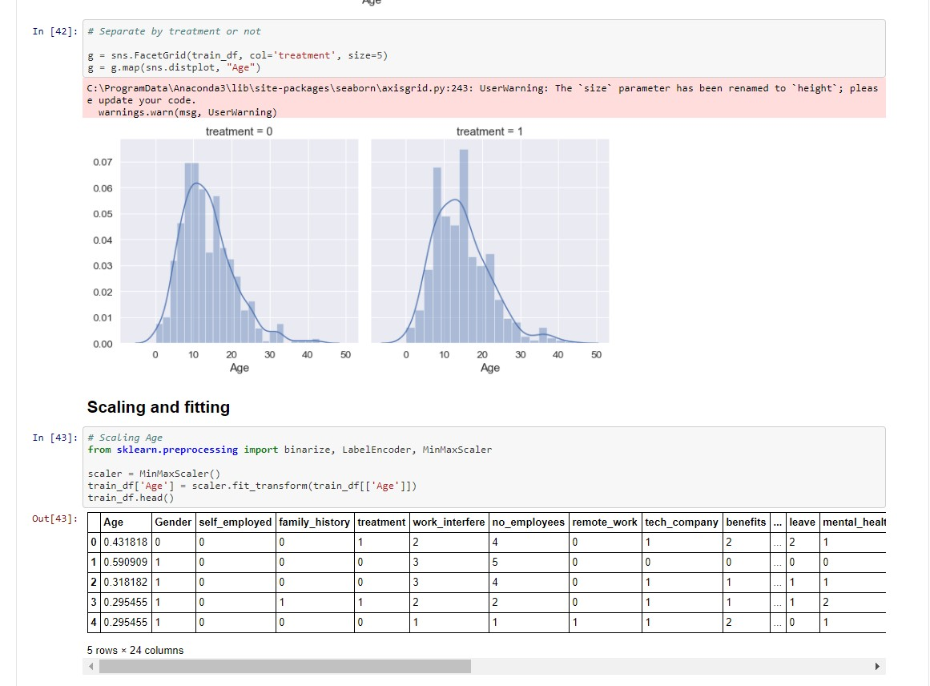

Slide 15
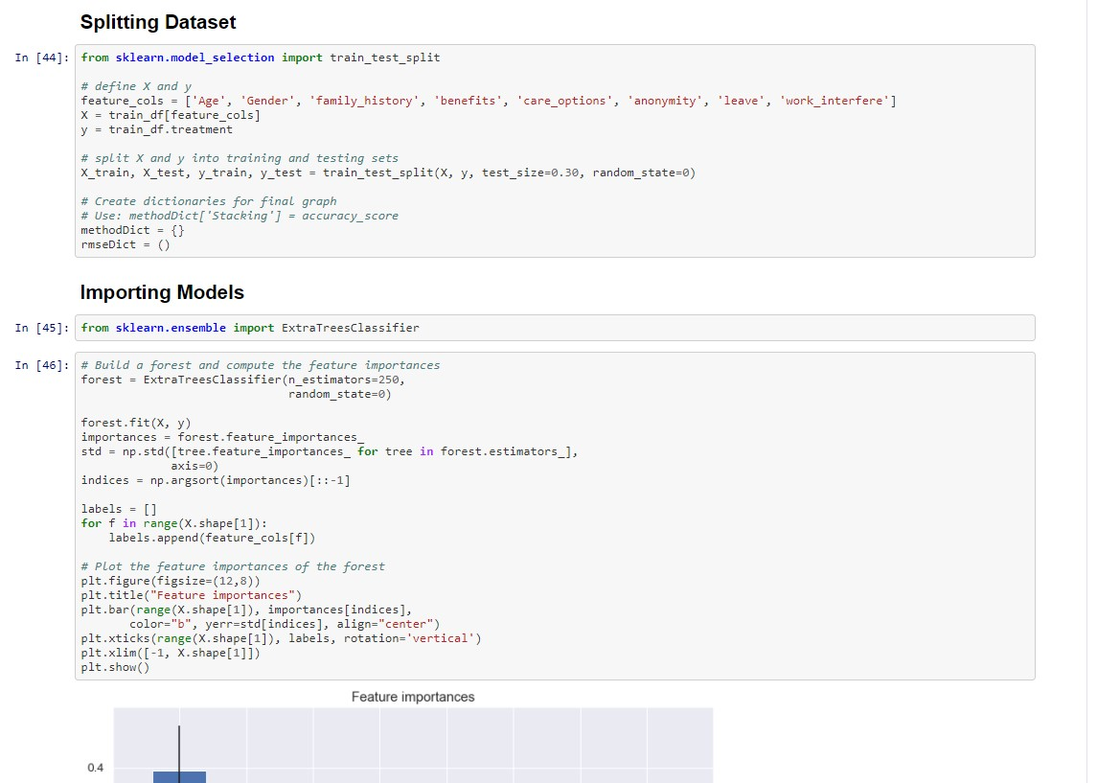
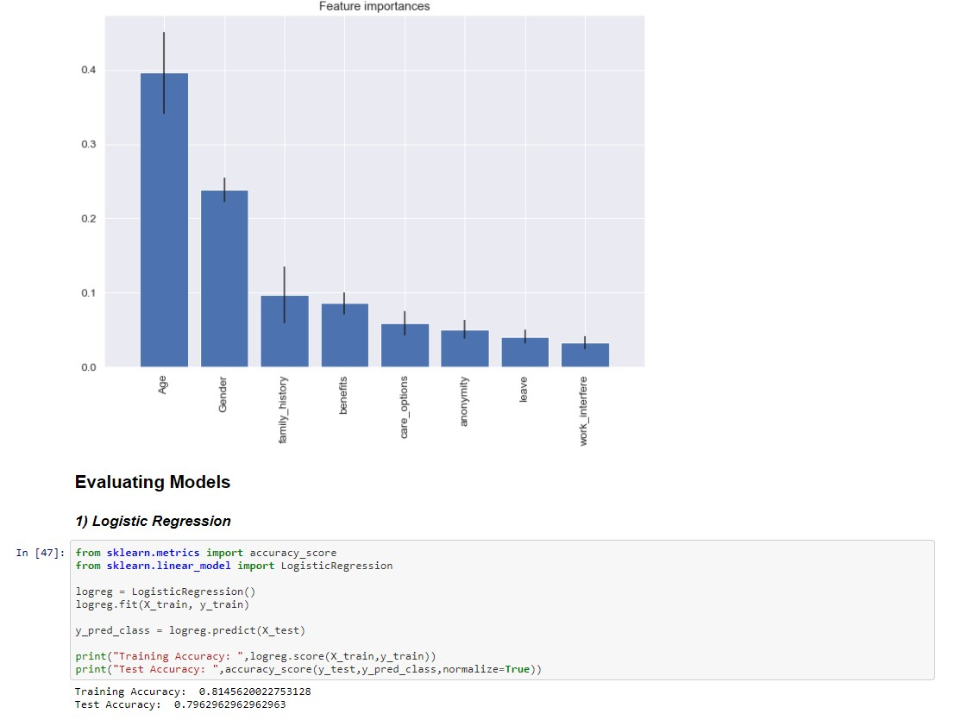

Slide 16
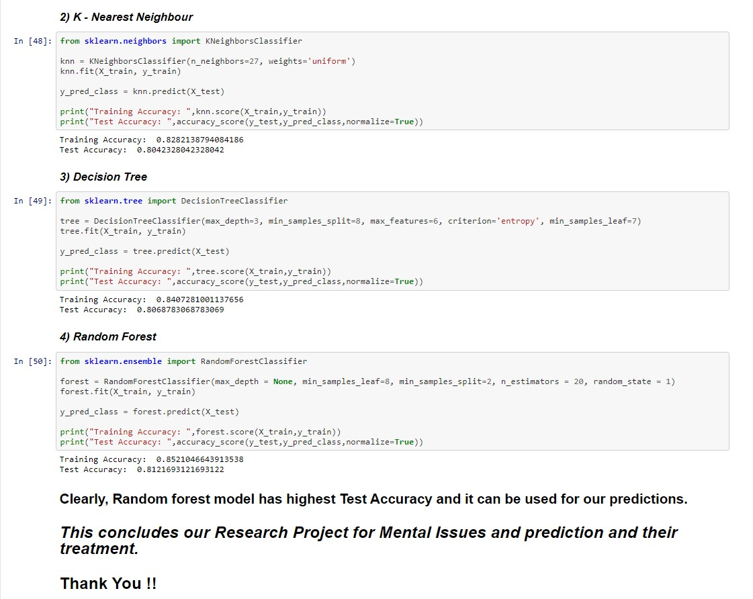

Slide 17
OBSERVATIONS
Clearly, Random forest model has highest Test Accuracy and it can be used for our predictions.
This concludes our Research Project for Mental Issues and prediction and their treatment.

Slide 18
CONCLUSION
In conclusion, this project we will describe the impact of different factors on the health of a person and will predict the if the person needs treatment or not. If he does, then how severe the condition is and how badly he needs to be treated to overcome his illness. In a nutshell, by this project, we will try to make a tech world employee’s life smooth and healthy as they are the working for the world and its future. As a team of beginners, we are not sure whether the results are best. We think over 80% of success rate will be good for our project on which we are working as a team. Thanks for reading, feedback will be appreciated.

Slide 19
REFERENCES
https://towardsdatascience.com/
https://www.kaggle.com/
Github link : https://github.com/dtdivyansh/Pianalytix/blob/main/PianalytixProject.ipynb

